Slide 1
The Role of Language Evolution in Digital Archives
Nina Tahmasebi, Chalmers Univ. of Technology
Thomas Risse, L3S Research Center
3rd International Workshop on Semantic Digital Archives (SDA)
26th September 2013 in Valetta, Malta

Slide 2
Language changes over time!
  Our language is DYNAMIC and changes with our culture, politics, technology, social media, etc.
  Different spellings over time
  New words are introduced
  Words change their meanings
In long-term digital archives → Problems!

Slide 3

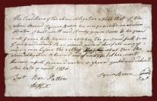
Problem 1: Finding Documents
Intention: ”I want to know
more about Stalingrad”
?
?
1800
1820
1840
1860
1880
1900
1920
1940
1960
1980
2000

Slide 4
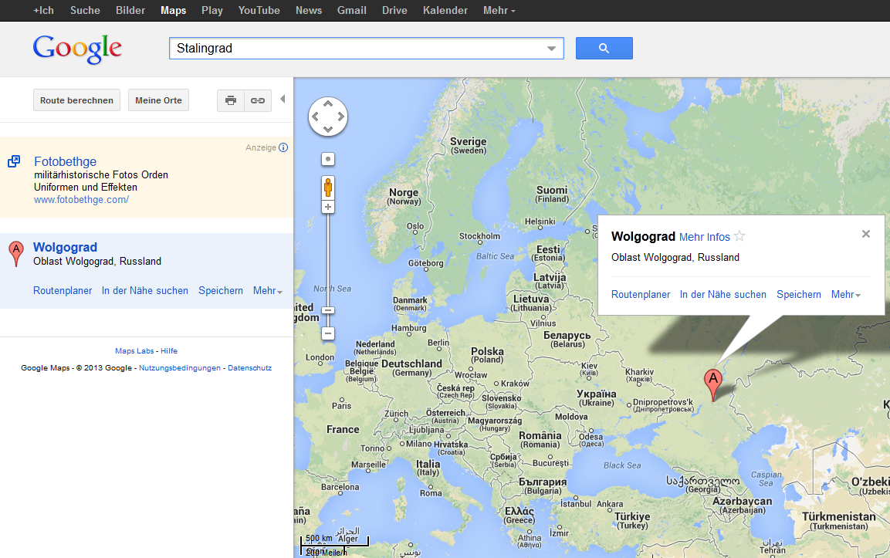
What is Google saying?
?
?
?

Slide 5
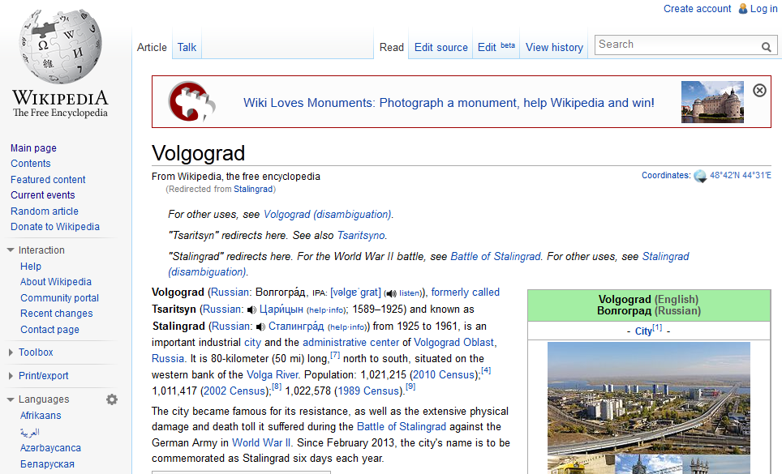
… and Wikipedia?
http://en.wikipedia.org/wiki/Stalingrad

Slide 6
Problem 1: Finding Documents
Tsaritsyn
Stalingrad
Volgograd
1589-1925
1925-1961
Sometimes the solution is in Wikipedia or a dictionary!
Other times:
  Not important enough?
  User generated content
  Slang/jargon/domain specific
Named Entity
Evolution

Slide 7
One solution – no Wikipedia etc!
Given a query (name):
    Identify change periods (CP) (BURST DETECTION!)
    Create one context per CP.
    → Capture at least two co-references
For more details see also next presentation about BlogNEER.
Tsaritsyn
Stalingrad
Volgograd
Change period
t₂
t₃
1925
1961
time
The "Hero City" of Stalingrad has been renamed Volgograd …. New York Times Nov. 11, 1961

Slide 8
Some results
St. Petersburg – Leningrad, Petrograd
Pope Benedict – Cardinal J. Ratzinger
Myanmar – Burma
Accenture – Andersen Consulting
Sean Combs – Puff Daddy, P. Diddy
    ~ 90% recall on our testset ¹ and
    NYTimes (1987-2007)
¹ http://www.l3s.de/neer-dataset/

Slide 9
What is missing?
What if the name is not mentioned often enough?
How do we find change periods without burst detection?
How to move forward? – Web data, blogs, twitter, historical personal letters…
Can we use resources? – Wikipedia etc.

Slide 10

Problem 2 – Interpreting
Exploring
The Times Archive
(1785-.1985)
Interesting article
about an opera performance
from 1787

Slide 11
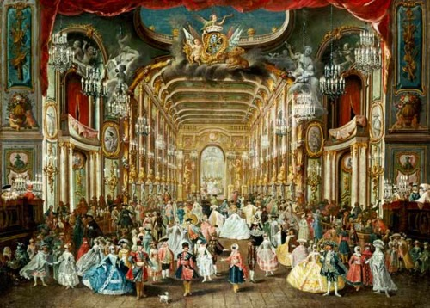

Slide 12
Problem 2 – Interpreting
This makes not much sense!!
”Sebastini’s benefit last night at the Opera House was overflowing with the fashionable and gay.”
The Times, April 27th, 1787
?
?
Were so many people homosexual in the 18th century?
?

Slide 13
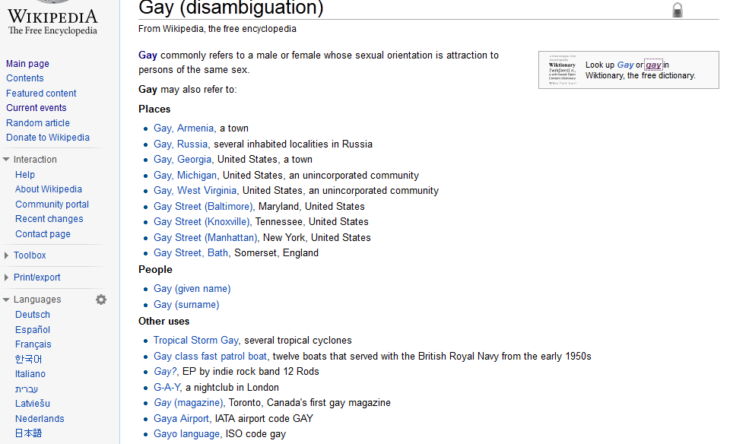
Let‘s ask the usual suspects …

Slide 14
Etymology helps
18th Century
Gay should be interpreted in the sense of happy, joyful, and lively
Starting from early 20th Century
Upcoming interpretation as „homosexual“
Interesting source for such information:
Wiktionary: http://en.wiktionary.org/

Slide 15
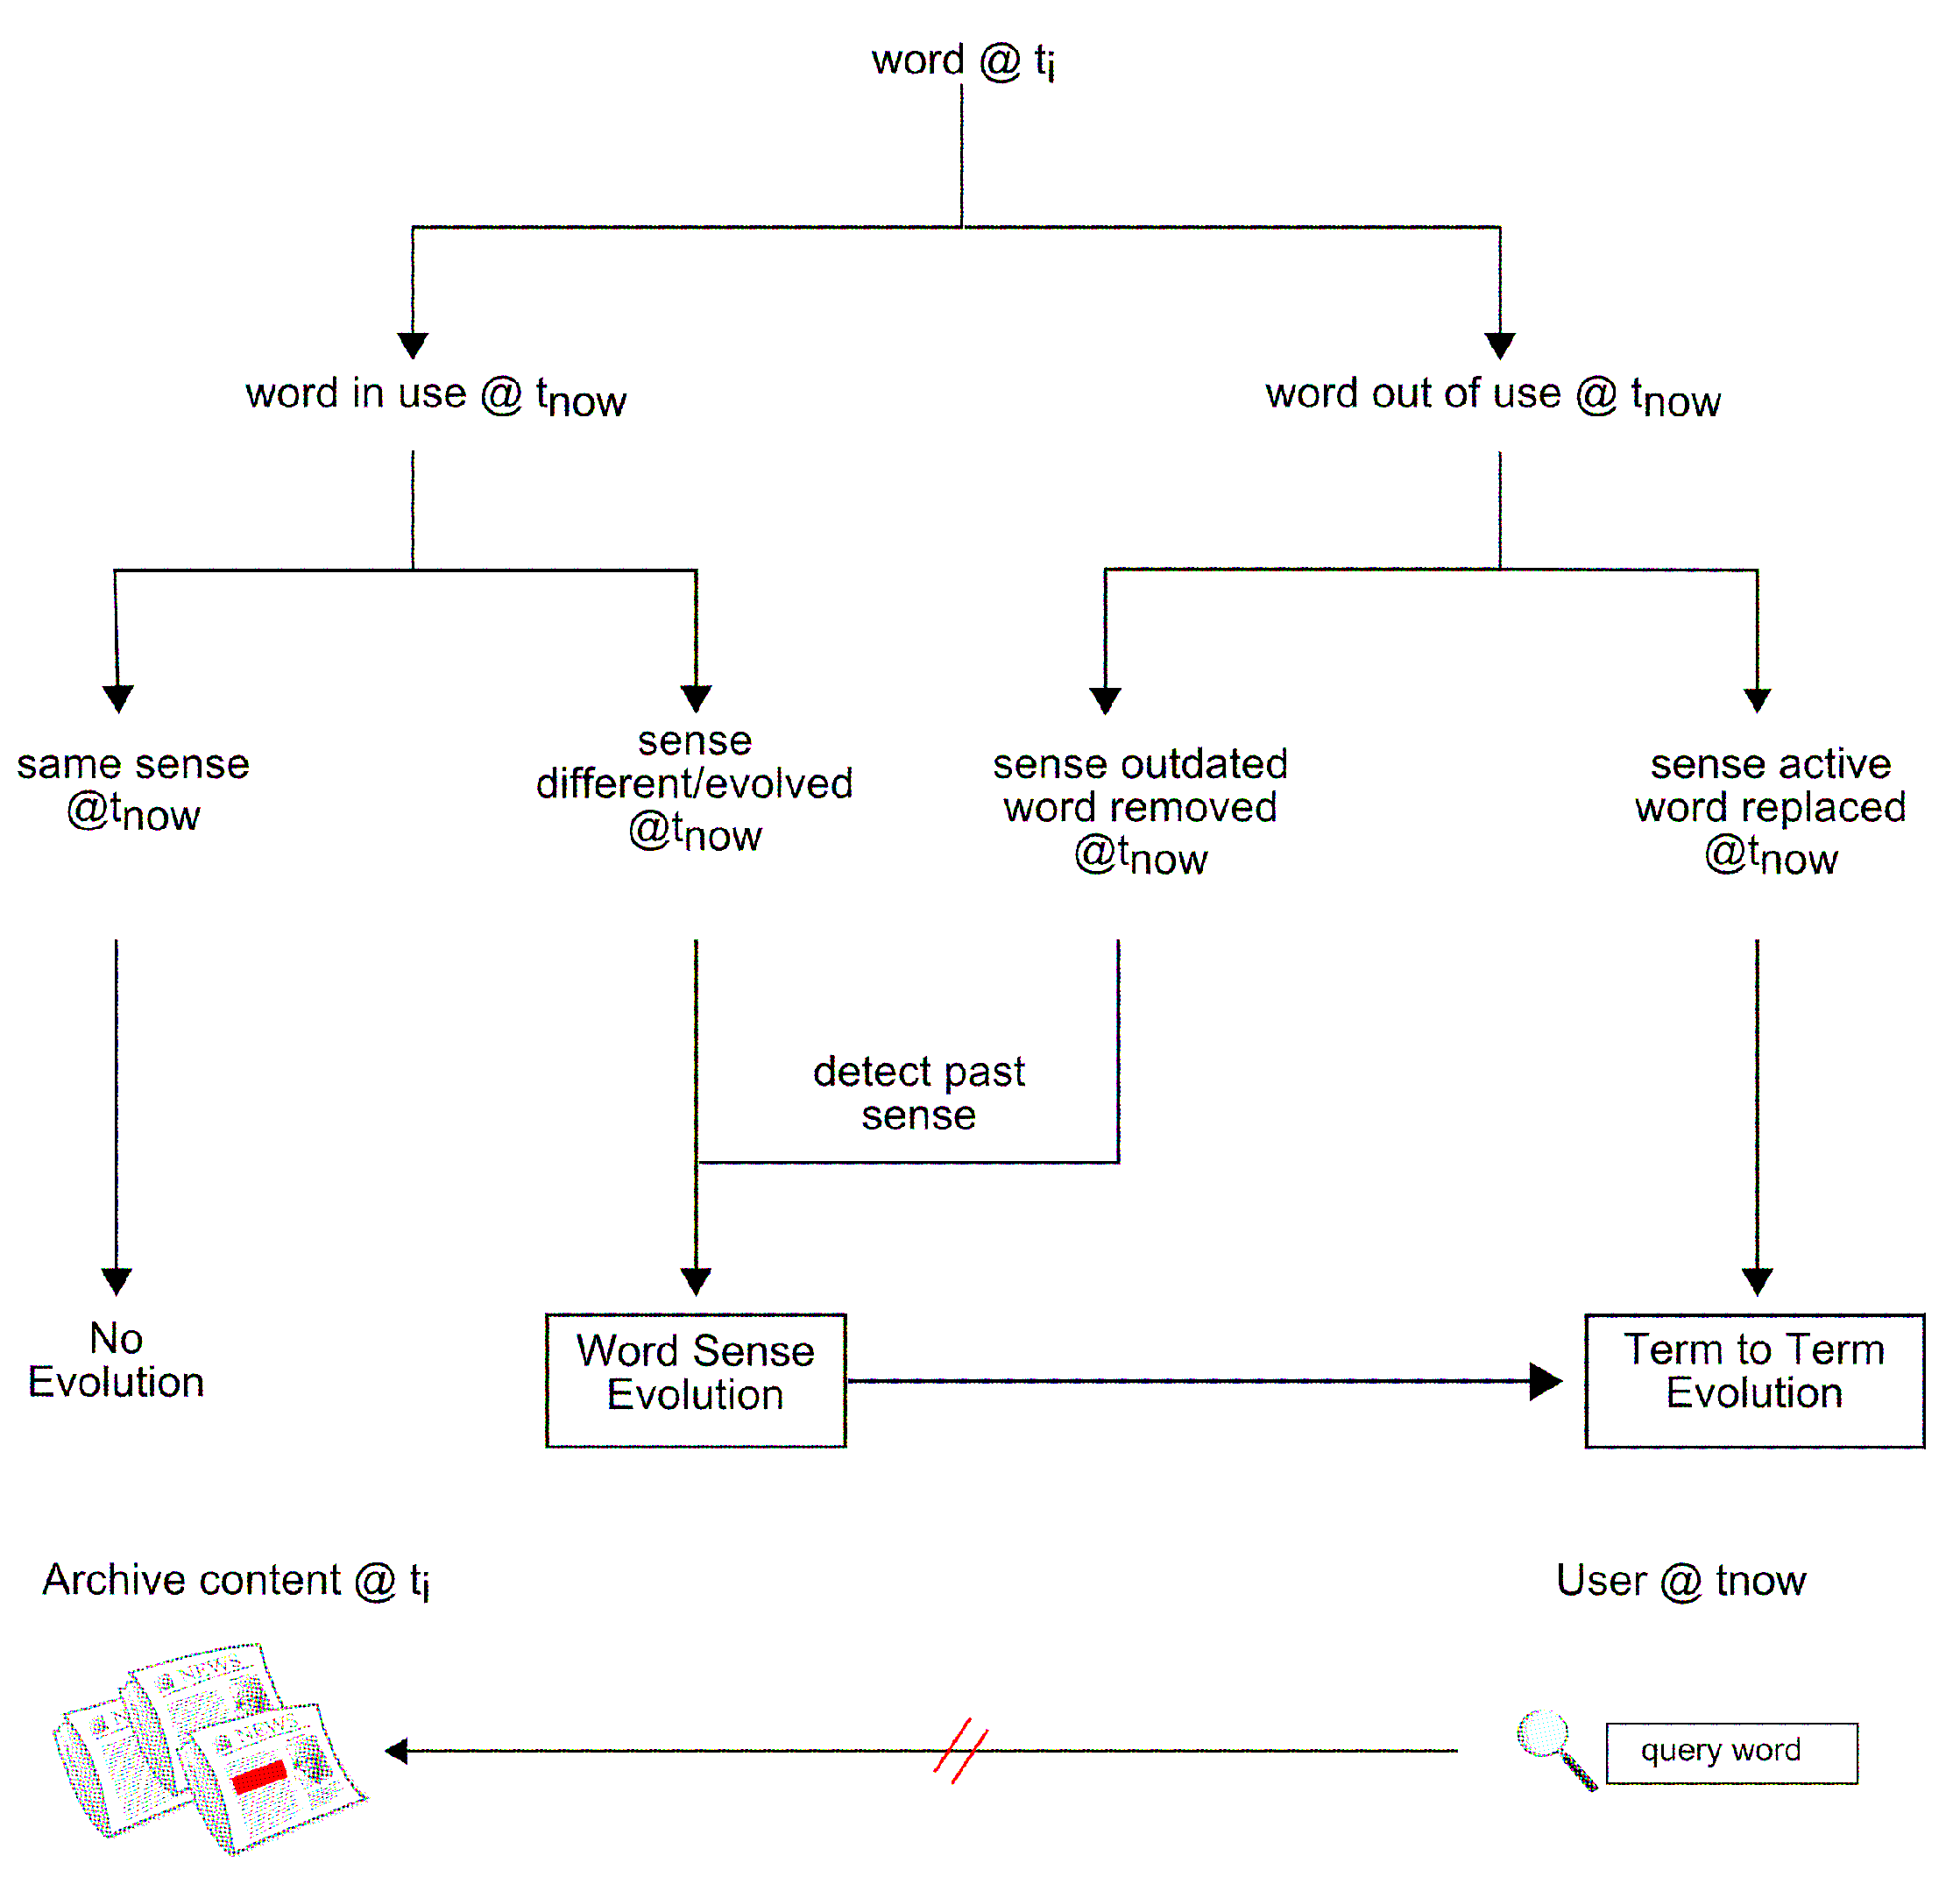
Diagram of Word Evolution

Slide 16
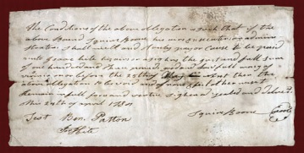
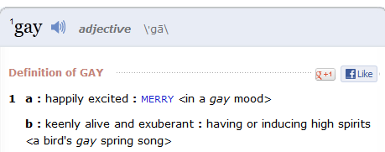

Word Sense Evolution
Given a word in a document at time t
1. Mark words that are likely to have a changed meaning
2. Find all changes to the word

Slide 17
Using Word Sense Discrimination
Find WS changes
Find WS from different time periods
Word Sense Tracking
NLP –
Terminology
Extraction
Relate terms –
Co-occurrence Graph
Find WS –
Clustering
Notes:
TASK 2
When we have completed the first step we have the technology for detecting word senses from one point in time.
Then we do this for several collections with some distance.
And then comes the second step which is to compare the descriptions of words in order to find the evolution

Slide 18



Some results – Travel
1803 literature, science, art, travel, voyage
1815 illustration, travels, science, travel, voyage
1843 history, romance, memoir, travel, voyage, novel
1867 travel, revival, colonial, foreign residence
1905 history, travel, book, mythology, biography
1906 full board, travel, best hotel
1928 sight, meal, reserved seat, superior hotel, travel
1966 loan, travel, good hotel, maintenance, fishing
1984 lanzarote, tenerife, sardinia, ravello, verona, travel

Slide 19

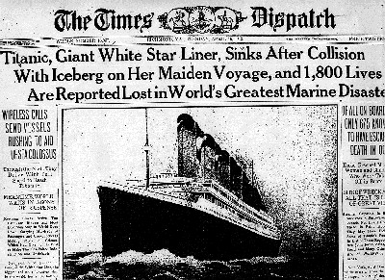

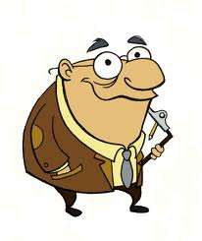
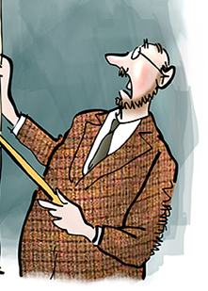

Perspectives
← ← Backward
Forward → →
Find all changes
Lack of Dictionaries, Wikipedia’s, WordNet’s
Few experts
OCR errors
Data sparsity
Prepare for future
Incremental changes
Resources exist
People can help
Noisy data
Data flood
Backward: We need automatic methods with no dependencies on external resources !
Notes:
Changes are current knowledge, and therefore people can help

Slide 20
Conclusions
Language evolution causes problems for finding and interpreting in digital archives.
And for types of processing topics/sentiments/event extraction
No plans exist for handling language evolution!
Future generations will face exactly the same problems as today.

Slide 21


Future Work – Semantic preservation
Crowdsourcing
  When can it be used?
  Must be done at time of harvest!
Store NLP processors, resources
(e.g, Wikipeida, WordNet , …)
with archives

Slide 22
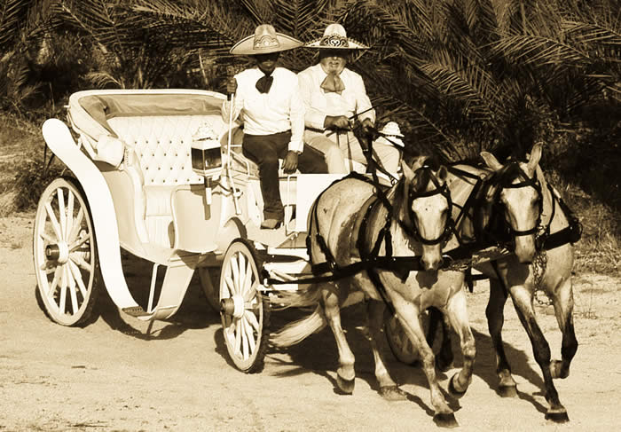
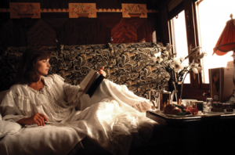
Going beyond: Semantic Archives
  Extracting implicit social graphs
  Tracking evolution
    opinions, events, entities, social graphs …
  Temporal multi-document summarization
  Finding the most descriptive document/s
    given a relation/change/evolution/…
  Interpret the culture of terms

Slide 23

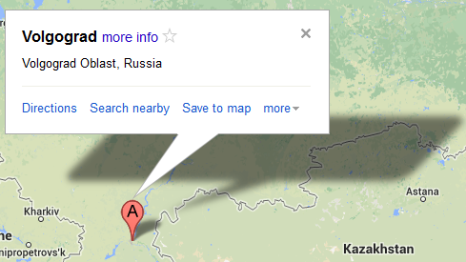


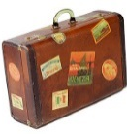
Thank You for Your time!
nina.tahmasebi@chalmers.se
risse@L3S.de

